Slide 1
CSI PACIFIC Return to Performance Program Proposal August 2025

Slide 2
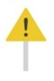
Step 1. The Problem
CSI Pacific does not have a RTP protocol
Every injury requires a massive time commitment for one of our practitioners
The problem is compounded by the fact that they must create the rehab program from scratch
As the practitioner is expected to provide a “state of the art” rehab, an immense amount of research is required
They must dive deeply into a plethora of nuanced topics.
Once they begin the rehab, they have no standardized way of keeping track of all the details
This makes it difficult to learn from each case, and to compound and share knowledge
Notes:
What problem (gap) are you actually trying to create a solution for?
Can you provide evidence that the problem exists?
Does the problem relate to the performance or health determinants of sport? Or could a solution to a problem result in positive impact for the institute, without negatively impacting our purpose?
Try and distill the problem down to its simplest form. Ideally you should be able to describe the problem you are solving in one or two sentences or bullet points.
Summarize: This is a massive time commitment in the present, and we do not have the protocol set up to innovate or improve in the future.
CH:
-the purpose of this RTP program is to provide a world-class, evidence-based
pathway leveraging cutting-edge sport science and a multi-disciplinary team approach to
rehabilitate and reintegrate winter sport athletes back to an elite level of competition
-one-third of World Cup Freestyle Ski and Alpine Ski athletes sustain a time-loss injury each season (Florenes4
et al., 2012)

Slide 3
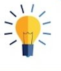
Step 2. Your Solution(s)
“Build something good with what we have now.”
An ACL Rehabilitation Protocol
Criteria Based Progression: Injury -> RTP & Beyond
Training Program Templates
Neuromuscular Testing Protocols
Notes:
A clear problem statement will help you focus your solution on solving just one main focus problem.
One Main Focus Problem
Build an ACL Rehab protocol targeted to able bodied athletes of any sport or level.
-This is a very specific solution, but it provides a foundation for later building other protocols (i.e. different injuries, … )
What we have:
-0.4 FTE of Andrew’s time
-some data from previous rehabilitations conducted within our facilities
-a network of practitioners who can offer expertise on different aspects of the protocol
-Force Plates
-High Performance facility
What we don’t have:
-money
-in house physiotherapy or other IST services
-isokinetic dynamometer
-underwater treadmill
Downstream solutions
-improved data management procedures within performance services
-

Slide 4
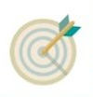
Step 3. Target Market
NSO Partner Athletes
Next Gen targeted athletes
PSO & Performance Nation
Notes:
Describe the market segments/type of client/customer you are targeting. Who does this problem focus on? What makes them unique? (e.g. is this just for elite athletes? Able or para or both? Next Gen? Community? Winter vs. Summer sports or both? NSO vs. PSO?)
Can you get any sense of projected number of client/customers that might be interested in this solution?
Are there any other aspects of the target market (or target customers/client) that are relevant to this problem and solution?

Slide 5
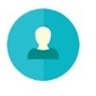
Step 4. Competition Benchmarking
World Leading-ish Examples
-
-
-
Actual Competition
-
-
-
Notes:
Who are your actual competitors? (name them, in some instances there might not be direct competition). Are they located locally, or within BC or within Canada or Internationally?
Describe your key differentiators that make your solution different than your competition.
[KPI: Is your solution unique enough that your target market (customers) will choose your solution over alternatives?]
Competition:
-CSI Calgary (collaborate)
-Private
-Fortius (n/a)
World Leading Examples:
(and one thing they do best that we can learn from)
-United States Ski and Snowboard
-SPARC Sports Physiotherapy & Athletic Rehabilitation Clinic – Ireland, Enda King
-OTP Return to Health and Performance ‘Think Tank’

Slide 6
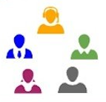
Step 5. Highlight Your Team Advantage
Project Lead – Andrew Kates
Experience in RTP leadership + applied sport/data science
History of delivering outcomes
Practical Approach + Research/Innovation
Winter Sport as a starting point (compared to other sports we service)
Network of Practitioners (gather expertise)
Notes:
Highlight how you and your time are the right team to execute on your vision!
Aspects of the CSI Pacific Institute Advantage should play front and center here. No matter how great or unique your solution is, if you don’t have the right people, places and programs, you won’t be able to see it to fruition.
-My approach: Practical implementation > Science/Research/Innovation
-Experience leading successful ACL Rehabs
-Experience with successful and unsuccessful collaboration
-

Slide 7
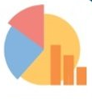
Step 6. Business Model
Build a prototype and present it to Core Stakeholders
Preferred business model:
NSOs pay upfront for access to this program in full (inexpensive)
We develop a PN version (a la carte, expensive)
PN version is available “on demand”
Estimated Costs | Description | Costs
Project Labour | 0.4 FTE of PS2 salary | ~$30k/year
Soft Goods | i.e. software | $0*
Hard Goods | Tindeq Dynamometer, misc. | ~$500
Notes:
Pull together a draft top-level forecast of potential revenues and expenses into a draft budget
Within the context of sport, show that in a not-for-profit model, there would be enough interest to support the solutions:
-Interest is a funny word, it’s more like “need”. Maybe some people are ”interested”
-We will be doing rehabs either way
Even if we don’t care about doing it well for the sake of it…
We might as well do it in a highly organized manner
-Build the thing, present it to them, convince NSOs to pay upfront
If someone gets hurt, the rehab is included in the agreement, and they know exactly what they are getting from the rehab.
Or they can pay the PN rate when someone gets injured..?
i.e. You pay $10k per year for full access OR you pay $20k for a 12 month rehab (this is a bargain for the full service including staff time commitment)
Is there enough revenues to cover costs in a sustainable manner?
-I feel like it’s not PS job to collect revenue
-Our job is to offer the best service possible, not to sell it or ensure collection of revenue
-PS does the work to generate the revenue, the revenue just doesn’t always get collected
AK:
-Our core business is supposed to be supporting Canadian high performance athletes. This is a crucial part of supporting them
-This would be the first comprehensive and open-source system within Canada
-i.e. Izzy: that was just service delivery, there was never really a structured, scalable protocol
-R&D:
There are a lot of opportunities just from improving our data management. R&D doesn’t have to involve a Biodex. It’s just a way to potentially fund it via grants etc.
-my proposal involves basically no cost, but it has a guaranteed outcome. The protocol will be delivered. It will be useable for any of our staff. From there we can probably market to NSOs, can
-What is the cost to not doing this? We keep having rehab cases to do, our practitioners work inefficiently to cover these on a case-by-case basis, we do not learn/grow/innovate, we do not have procedures in place to inform research and innovation, we have no way to properly value this service and the organization (and practitioners) do not get properly compensated.
CH:
-Increased and stable NSO and PSO investment in performance services
-strengthening stakeholder engagement byfostering collaboration with NSO and PSO partners
-scaled private pay RTP service for PN
-The population in Whistler is approaching 16,000 residents, with almost 30,000 in Squamish and 4,000 in Pemberton
-I think we build the protocol without a Biodex and then we can decide if and how we go about getting one later
-grants, R&D partnerships

Slide 8

Step 7. Milestones
Aug - Dec 2025
-Draft of ACL Protocol
Jan - April 2026
-Work to align with DS
April 2026
-Version 1 of ACL Protocol
Notes:
Highlight your upcoming goals and when you plan to achieve them. Consider developing a draft Gantt Chart for key milestones.
AK
-my proposal is far more internal.. I don’t think it’s valuable to include all the stakeholders at this stage
-build a prototype
-ensure it aligns with CSI policies and procedures and is feasible within those
CH
Discovery and Planning (0-3 months)
-comprehensive stakeholder consultation and needs analysis
-We discover that athletes sometimes get hurt and there is a lack of effective, structured protocols to support the rehab process and include all stakeholders
Phase 2: Design and Development (months 3–6)
-facility enhancements will be planned
-Biodex isokinetic dynamometer equipment will be procured
-Operational guidelines and best practice protocols will be developed
-staff training
-Establishing research partnerships with academic and clinical institutions
-Build the protocol document
-Set up Tindeq
Phase 3: Pilot Implementation and Testing (months 6–12)
-initial rollout of RTP services through a pilot program in collaboration with select winter sport NSOs
-development of RTP service packages accessible to the broader public via Performance Nation
Phase 4: Full-Scale Implementation and Launch (months 12–18)
-fully operational and accessible to all NSO and PSO partners as well as the public via Performance Nation
-comprehensive marketing and communication strategy
Phase 5: Evaluation and Continuous Improvement (ongoing)
-monitoring program outcomes against the established KPIs
-regular audits and impact assessments to evaluate effectiveness, refine protocols, and integrate emerging
technologies

Slide 9
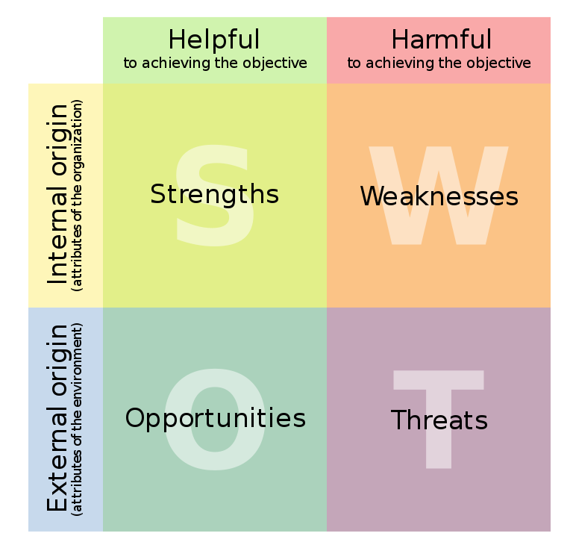
Multi Step Project “PITCH”
Step 8. SWOT (optional)
If you have been able to collect enough information in steps 1 through 7, consider developing a single slide SWOT analysis.
Notes:
We are starting from zero investment into this,
Now committing 0.4FTE of a PS2

